Slide 1
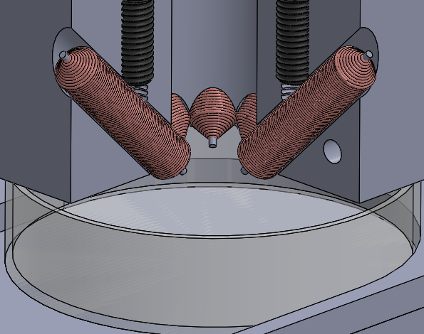
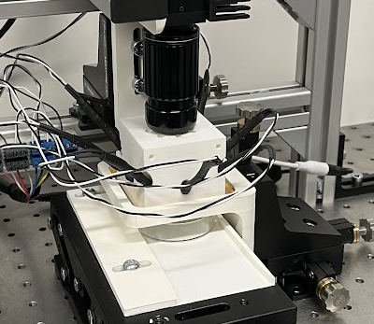




a
b
c
RL training
Solenoids
Task
description
Prompt
Top-view
camera
Language model
Outcome
Reward
Trained policy
$$π$$
Control
policy
Magnetic particle
Simulator
Action

Slide 2
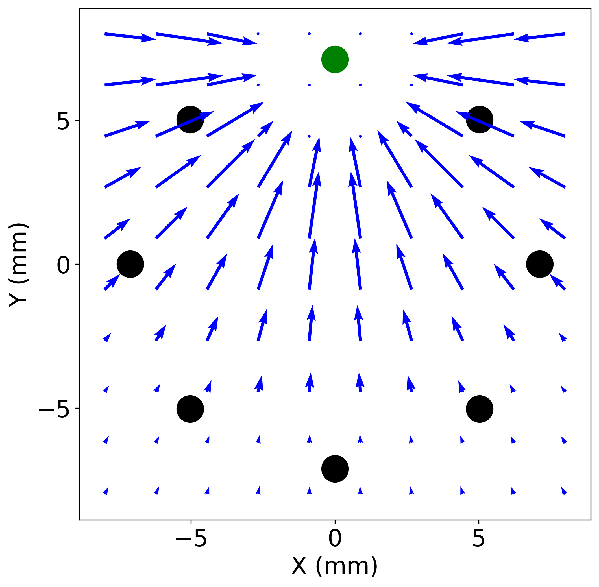
Max
Current applied to solenoids
Min
Predicted velocity field

Slide 3
a
c
Prompt:
"You are provided description of a 2D workspace where location of each point can be represented as (x, y) where x is the x-axis co-ordinate while y is the y-axis coordinate. The center of the workspace is at (0,0) and the top-right corner is at (360,360).
You need to critique the actions of the particle. You will be provided with the goal position, the previous position of the particle and the new position of the particle. You can output a value between -9 and +9 with an accuracy of 1. Actions that are harmful for achievement of the goal position should have a value closer to -9 while actions that are beneficial for the achievement of the goal should have a value closer to +9.
You must only output a single float value. Do not output any other text in your response. Do not output any code or explanation.”
Prompt:
"You are provided description of a 2D workspace where location of each point can be represented as (x, y) where x is the x-axis co-ordinate while y is the y-axis co-ordinate. The center of the workspace is at (0,0) and the top-right corner is at (360,360).
You need to critique the actions of the particle. You will be provided with the goal position, the previous position of the particle and the new position of the particle. You can output a value between -9 and +9 with an accuracy of 1. Actions that are harmful for achievement of the goal position should have a value closer to -9 while actions that are beneficial for the achievement of the goal should have a value closer to +9.
Some examples of input data and scores are:
The particle was located at (200.00, 150.00).
The particle is currently located at (180.00, 120.00).
The goal is currently located at (-20.00, -15.00).
What is the reward score?
Response: 9
The particle was located at (-250.00, -150.00).
The particle is currently located at (-200.00, -150.00).
The goal is currently located at (75.00, 180.00).
What is the reward score?
Response: 3
The particle was located at (50.00, -75.00).
The particle is currently located at (50.00, -60.00).
The goal is currently located at (-150.00, -125.00).
What is the reward score?
Response: 1
The particle was located at (-200.00, 150.00).
The particle is currently located at (200.00, 150.00).
The goal is currently located at (0.00, 0.00).
What is the reward score?
Response: 0
The particle was located at (17.25, -160.50).
The particle is currently located at (16.50, -159.75).
The goal is currently located at (20.75, -250.00).
What is the reward score?
Response: -8
You must only output a single float value. Do not output any other text in your response. Do not output any code or explanation..”
Workspace
description
Workspace
description
Objective description
Objective description
b
Prompt:
"You are provided description of a 2D workspace where location of each point can be represented as (x, y) where x is the x-axis co-ordinate while y is the y-axis co-ordinate. The center of the workspace is at (0,0) and the top-right corner is at (360,360). \n
You need to critique the actions of the particle. You will be provided with the goal position, the previous position of the particle and the new position of the particle. You can output a value between -9 and +9 with an accuracy of 1. Actions that are harmful for achievement of the goal position should have a value closer to -9 while actions that are beneficial for the achievement of the goal should have a value closer to +9.
The particle was located at (17.25, -160.50).
The particle is currently located at (16.50, -159.75).
The goal is currently located at (5.75, -57.00).
What is the reward score?
Response: 1
Explanation (Do not generate this in your output): The particle started at (17.25, -160.50) and ended at (16.50, -159.75), while the goal was at (5.75, -57.00). The distance to the goal at starting position was 104.13 while the distance at ending position was 103.31. Since, 103.31 < 104.13, the particle moved closer to the goal the score should be positive. But the magnitude of reduction in distance isn’t very high so the magnitude should be low. Therefore, a score of 1 seems appropriate.
You must only output a single float value. Do not output any other text in your response. Do not output any code or explanation.”
Workspace
description
Objective description
Five example transitions and reward scores
Example transition and reward score
Explanation
Objective description
(continuation)
Objective description
(continuation)

Slide 4
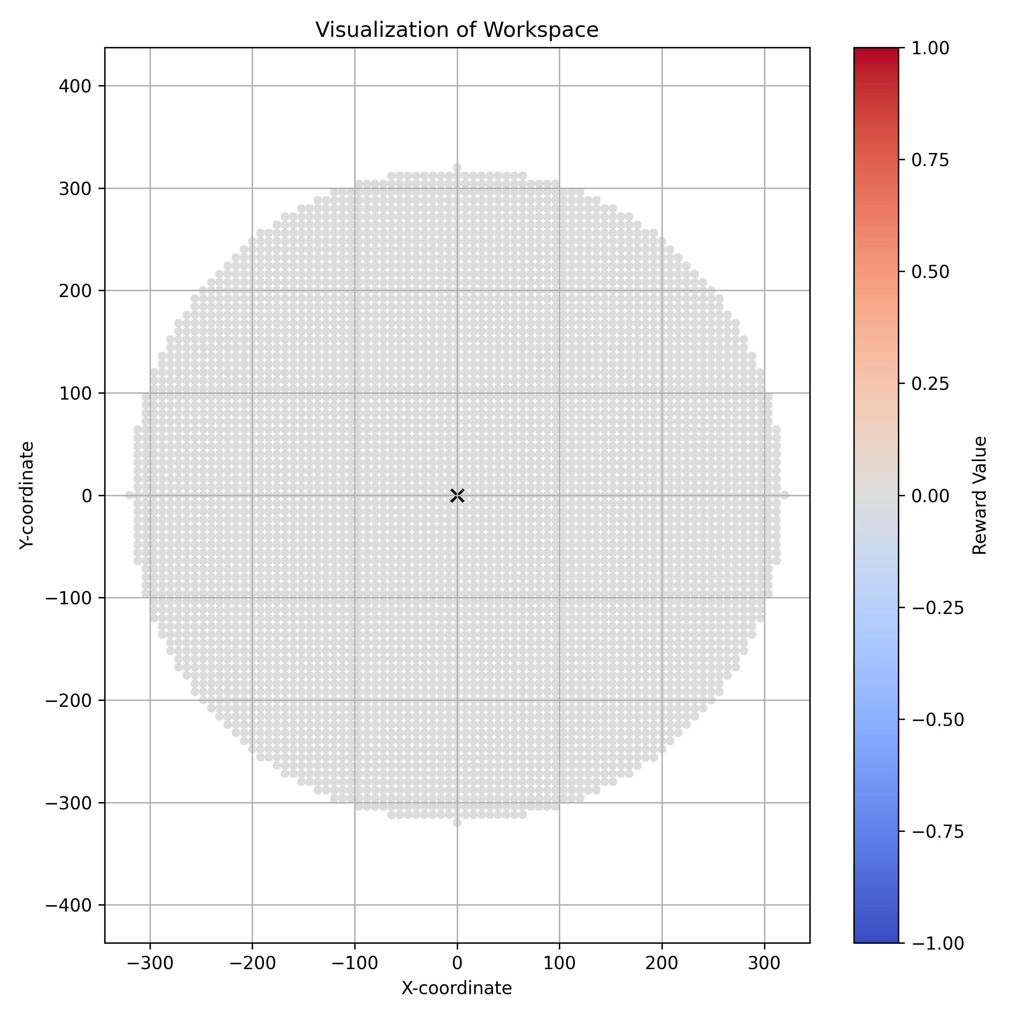
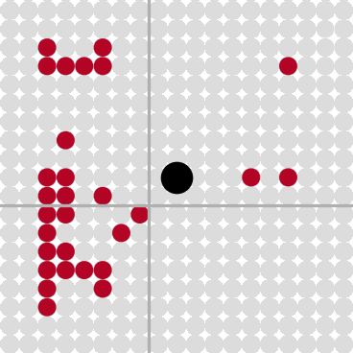
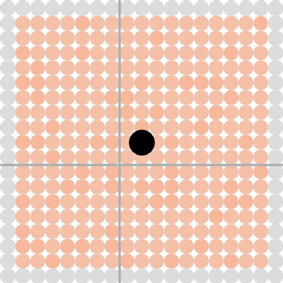
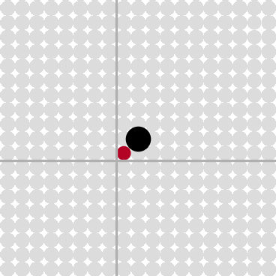
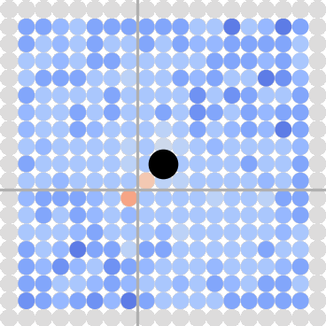
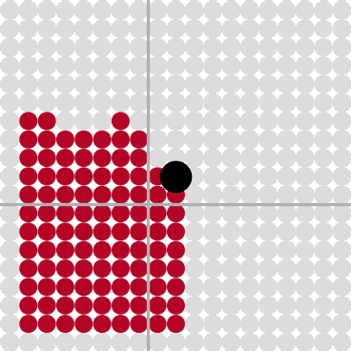
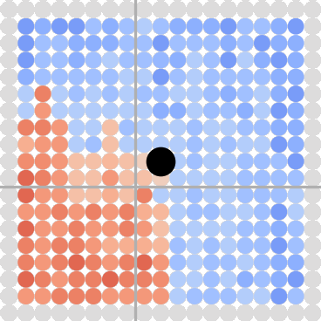
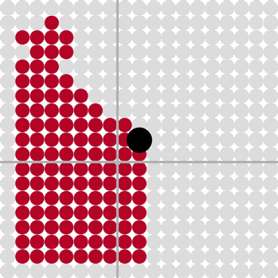
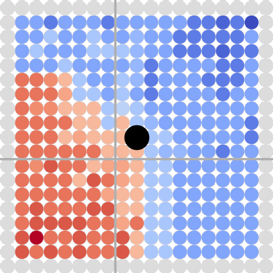
Reward maps for one-shot with explanation prompt
Binary rewards
Continuous rewards
QWEN-3B
QWEN-3B
Particle
QWEN-7B
QWEN-7B
Reward
Goal
QWEN-14B
QWEN-14B
QWEN-32B
QWEN-32B

Slide 5
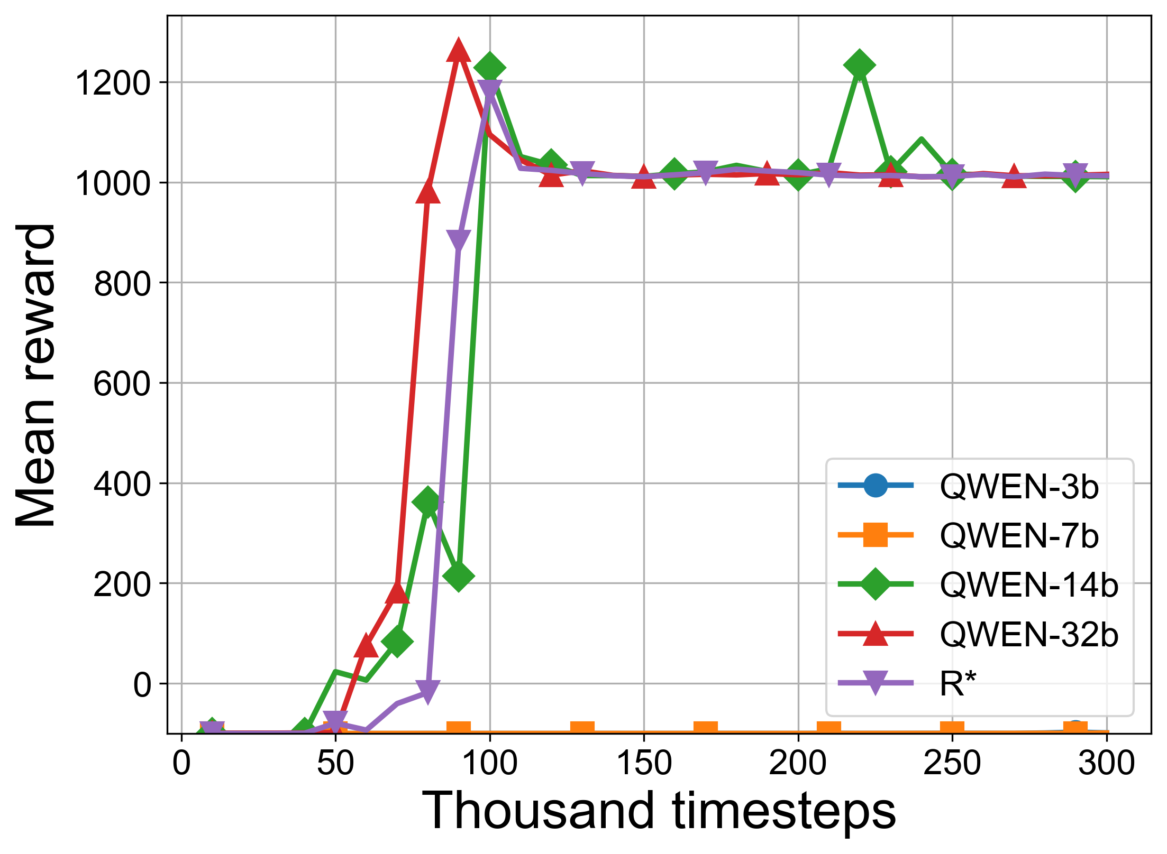
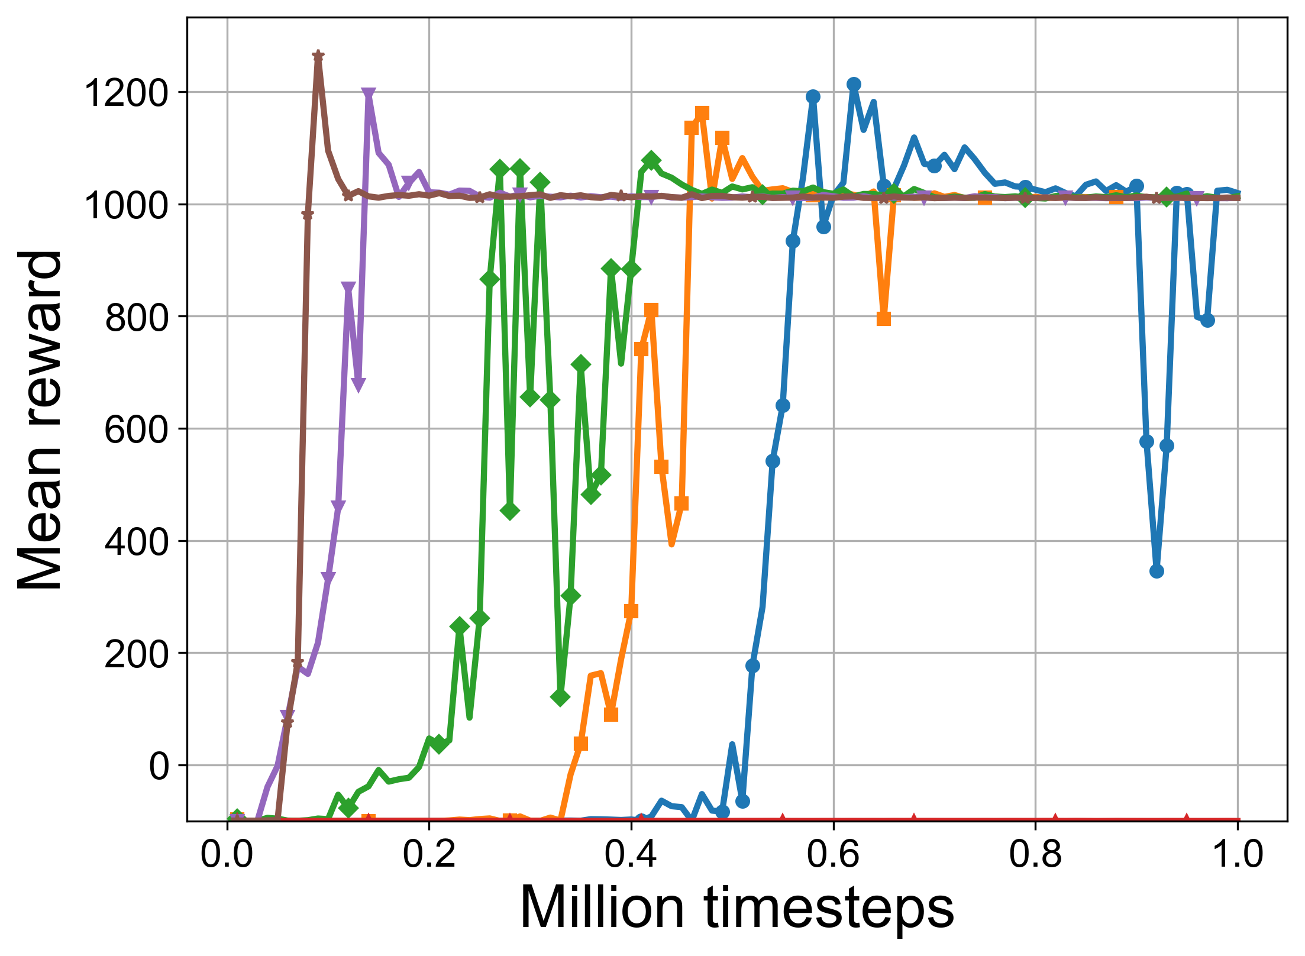


a
One-shot with explanation & binary reward
b
QWEN-32B model
Continuous reward:
zero-shot
few-shot with examples
one-shot with explanation
Binary reward:
zero-shot
few-shot with examples
one-shot with explanation

Slide 6
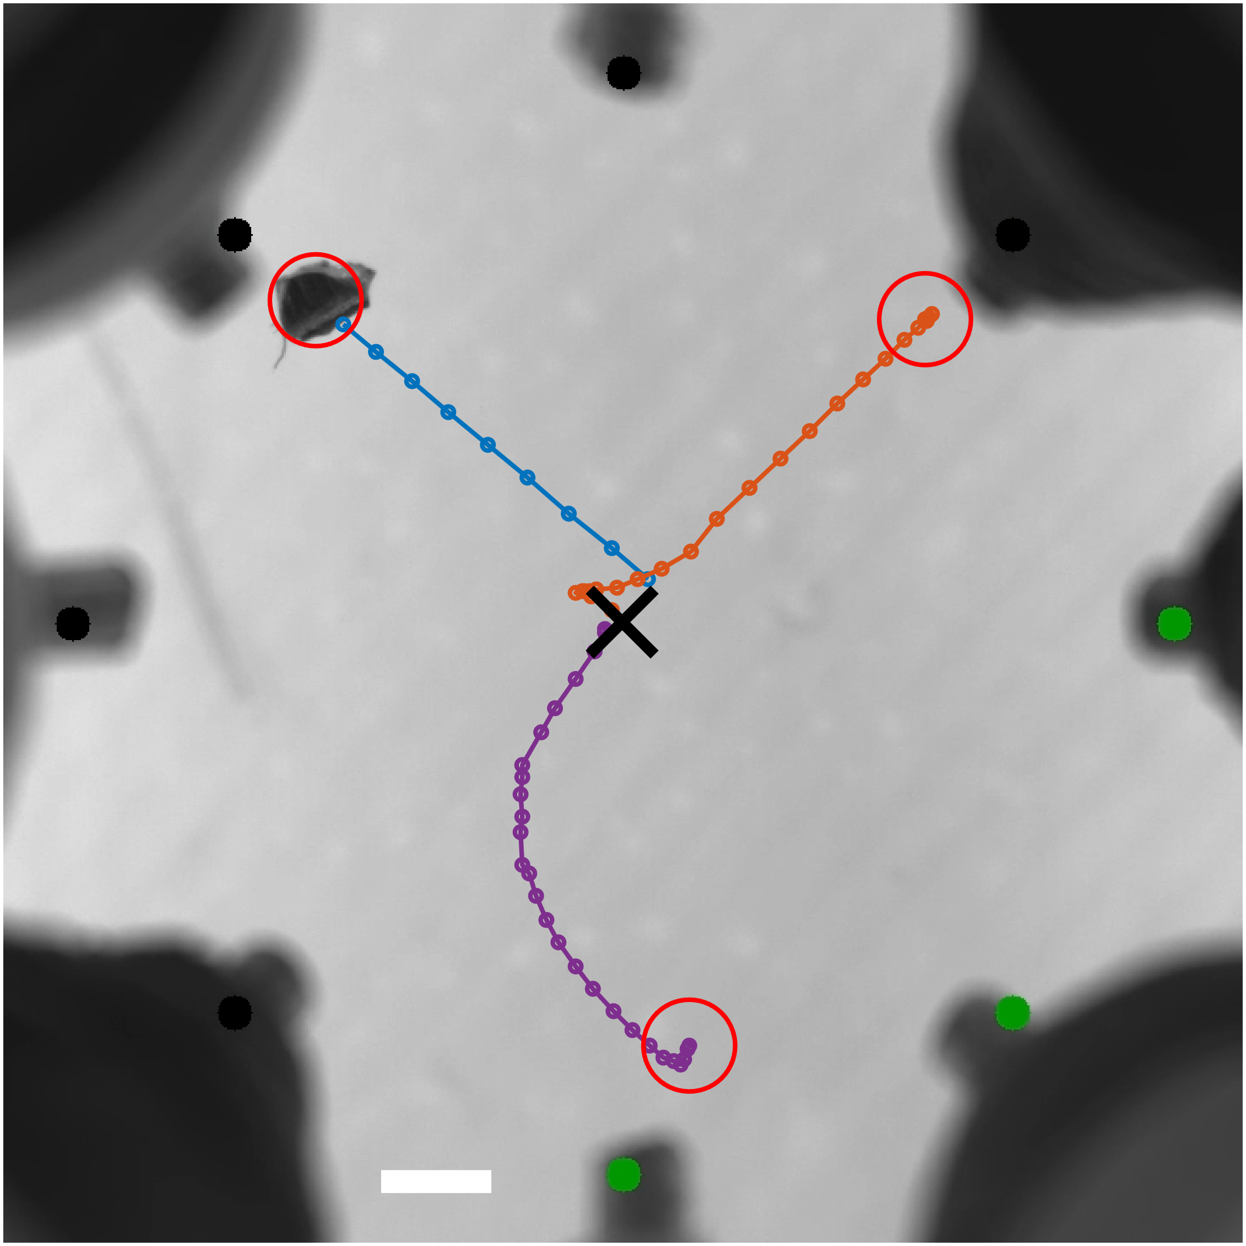



Solenoid 1
Max
Solenoid 8
Solenoid 2
Current applied to solenoids
Particle
Solenoid 7
Min
Goal
Solenoid 3
Initial position of particle
Trajectory repetition:
Solenoid 6
Solenoid 4
1
2
3
Solenoid 5

